Slide 1
Increased Osteoporosis Risk and Risk Factors in Parkinson’s Disease
Samed Oğuzhan Akın
Gülsen Babacan Yıldız, MD
Tuğçe Yıldız, MD

Slide 2
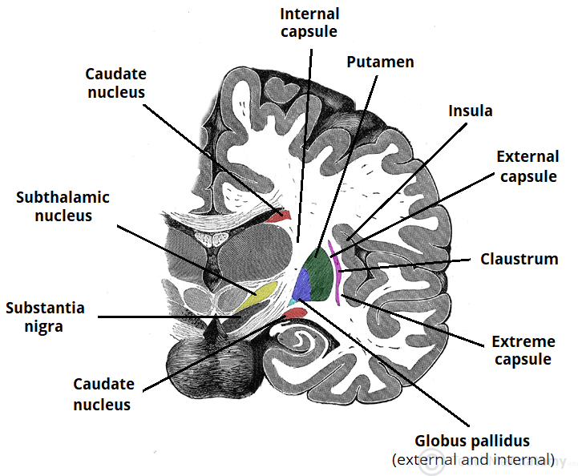
What is Parkinson’s Disease?
Parkinson's Disease is a neurodegenerative disease that is mainly seen with damage to the basal ganglia and is the most common after Alzheimer's disease.
What is the main pathology?
The basic pathology is disruption in synapse stimulation in the basal ganglia in favor of acetylcholine against dopamine. Our treatment is still based on tipping this balance in favor of dopamine. There are many reasons from oxidative stress to genetic mutations

Slide 3
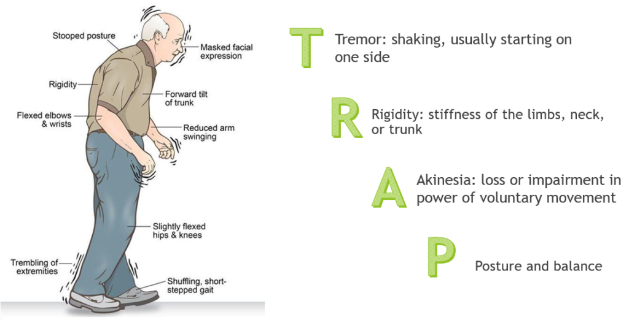

Slide 4
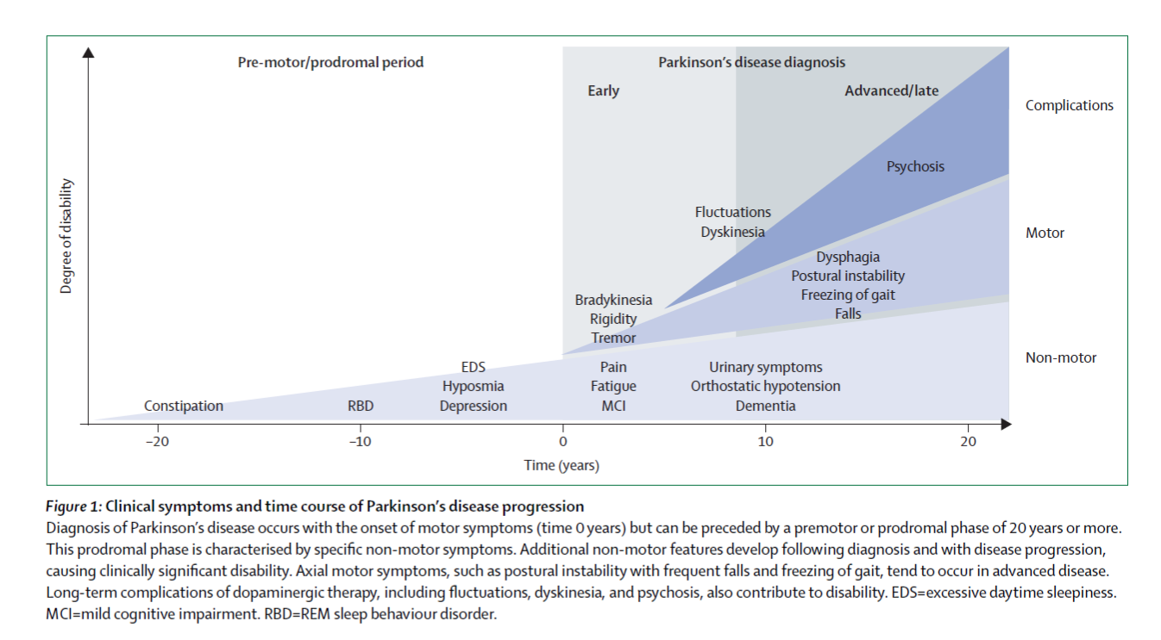

Slide 5
Aim of the Study
To see the risk of osteoporosis
Effects of treatment types on serum calcium and vitamin D
Effects of duration of disease on serum calcium and vitamin D
To see how 25(OH) vitamin D and calcium levels will be as the severity of the disease increases

Slide 6
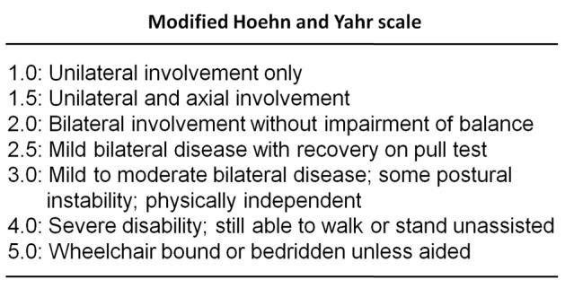
Materials and Methods
23 PD patients and 23 healthy individuals were included to the study
PD patients were between 40 and 65 years old and had no other neurological disease
The serum obtained by centrifugation of venous blood samples taken in 2017 was used
The serums stored in a refrigerator at -80 degrees.
We asked to patients:
When did it start? When was the diagnosis made?
Which medication are you taking?
We performed a detailed neurological evaluation of the patient group.
We chose the appropriate stage in the Hoehn Yahr Scale according to our physical examination

Slide 7
Materials and Methods
Serum calcium, 25(OH) vitamin D, copper and zinc values were compared between the patient and the control groups by using T-test
In the patient group, we compared the results with duration of disease, treatment and Hoehn Yahr Scale with Spearman's rank correlation coefficient
We used IBM SPSS program for statistical analysis

Slide 8
Results
The levels of 25(OH) vitamin D in the patient group were lower than control group but there was no significant difference between them
In patient group. The levels of 25(OH)vitamin D had a negative correlation with Hoehn Yahr Staging and duration of disesase but also there was no significant differences in patient group
 | Patient Group | Control Group
25(OH) vitamin D | 17,37±10,14 | 26,28±28,48 | P=0.164

Slide 9
Results
The mean of calcium levels in the patient and control groups were similar.
There was a negative correlation between Hoehn Yahr Staging and the levels of calcium in the patient group
 | Patient Group | Control Group
Calcium | 8,917±0,3537 | 9,026±0,3558 | P=0.304
Correlation Coefficent | -0.446
Sig. | P=0.033

Slide 10
Results
Between patient and control group, there was no significant difference for the levels of copper and zinc.
 | Patient Group | Control Group
Copper | 101.861±23.84 | 109.996±44.60 | P=0.445
Zinc | 75.70±9.819 | 78.91±7.937 | P=0.228

Slide 11
Conclusion
25(OH)D vitamin and calcium levels may decrease while PD progressing.
This is an issue that may be a risk of osteoporosis in the future as the life expectancy of patients increase.
We think that more comprehensive studies are needed.

Slide 12
References
1. Babacan-Yıldız G, Bazal Ganglia ve Hareket Bozuklukları. Nöroloji’nin ABC’si , İstanbul: İstanbul Tip Kitabevleri; 2018, p. 57-68
2. Sleeman I, Aspray T, Lawson R, et al. The Role of Vitamin D in Disease Progression in Early Parkinson's Disease. J Parkinsons Dis. 2017;7(4):669–675. doi:10.3233/JPD-171122
3. Handa, K., Kiyohara, S., Yamakawa, T. et al. Bone loss caused by dopaminergic degeneration and levodopa treatment in Parkinson’s disease model mice. Sci Rep 9, 13768 (2019) doi:10.1038/s41598-019-50336-4
4. Bivona G, et al. Standardized measurement of circulating vitamin D [25(OH)D] and its putative role as a serum biomarker in Alzheimer's disease and Parkinson's disease. Clinical Chimica Acta 2019; 497:82-87. doi:10.1016/j.cca.2019.07.022
5. Van den Bos F, Speelman AD, et al. Bone mineral density and vitamin D status in Parkinson’s disease patients. J Neurol 2013; 260:754-760 doi:10.1007/s00415-0001112-6697
6. Metta V, Sanchez TC, Padmakumar C. Osteoporosis: A Hidden Nonmotor Face of Parkinson's Disease. Int Rev Neurobiol. 2017;134:877-890. doi: 10.1016/bs.irn.2017.05.034. Epub 2017 Jul 10
7. Luo X, Ou R, Dutta R, Tian Y, Xiong H, Shang H. Association Between Serum Vitamin D Levels and Parkinson's Disease: A Systematic Review and Meta-Analysis. Front Neurol. 2018;9:909. Published 2018 Nov 12. doi:10.3389/fneur.2018.00909
8. Sato Y, Yoshiaki H, et al. Abnormal Bone and Calcium Metabolism in immobilized Parkinson’s Disease Patients. Movement Disorder Society 2005, Vol.20 No.12 pp. 1598-1603
9. Evatt ML, et al. Prevalence of Vitamin D Insufficiency in Patients with Parkinson Disease and Alzheimer Disease. Arch Neurol. 2008;65(10):1348-1352
10. Nissou MF, Brocard J, El Atifi M, et al. The transcriptomic response of miced neuron-glial cell cultures to 1,25-dihydroxyvitamin D3 includes genes limiting the progressions of neurodegenerative diseases. J Alzheimer Dis 2013;35(January,3):553-64

Slide 13
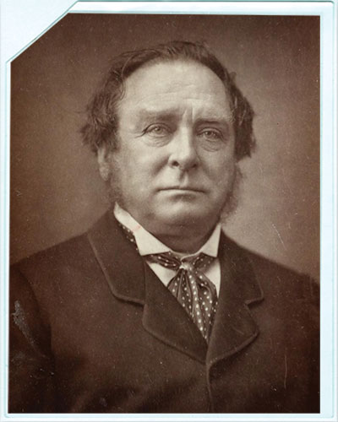
Thank you
for
your time

